Slide 1
BIOMEDIN 215 Data Science in Medicine
Nigam Shah, MBBS, PhD
nigam@stanford.edu

Slide 2
Quick recap
Structured data will need be transformed into analysis ready datasets from databases.
Feature spaces are often reduced using knowledge-graphs or via data-driven methods.
You can create additional features from the raw data.
Missing data can be imputed with varying levels of sophistication (but be careful!).
Your effectiveness in doing these tasks will increase by knowing some biology and medicine.
Notes:
I am still a little confused by the discussion of missing data, particularly the phrase "are the 0s an absence of the feature, or was it just not measured, or not needed?”
"Think about whether distinctions between low-level features are relevant to your problem”
How we can merge features based on existing knowledge
Information content

Slide 3
Goals for today:
Why bother with handling text?
Where does clinical text come from, and what does it look like?
Challenges unique to clinical text
Methods to process clinical text

Slide 4
Clinical vs. Biomedical Text
Biomedical text appears in books, articles, literature abstracts, posters.
Clinical text is written by clinicians or healthcare providers. Describes patients, their pathologies, their personal, social and medical histories, findings made during interviews or procedures, etc.

Slide 5
BREAKOUT: You want to find everyone who has one of the following:
“refeeding syndrome”
“peripheral artery disease”
“response to chemotherapy”
and believe that using just ICD codes won’t work. You want to use the textual notes.
Discuss with your colleagues the problems you might run into.

Slide 6
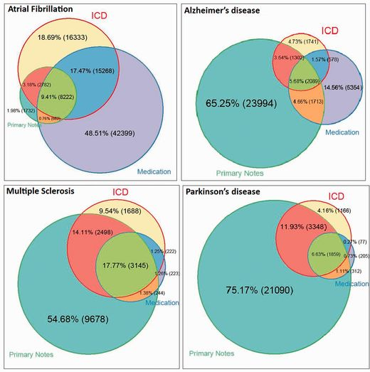
The utility of using features from text
Wei WQ, et al 2015 JAMIA

Slide 7
NLP in a few slides
This is not a review of clinical text processing systems. We used to do that in prior years, and I can share material if anyone wants to review.

Slide 8
Tokenization
Task: word detection, sentence boundary detection
The patient has coronary artery disease and
has undergone multiple balloon angioplasties .
The | patient | has | coronary | artery | disease | and |
has | undergone | multiple | balloon | angioplasties | .

Slide 9
Part-of-Speech tagging
Task: Classify words and phrases in the document as nouns, verbs, etc.
The | patient | has | coronary | artery | disease | and |
has | undergone | multiple | balloon | angioplasties | .
The | patient | has | coronary | artery | disease | and |
has | undergone | multiple | balloon | angioplasties | .

Slide 10
Shallow and deep parsing
Shallow parsing is an analysis of a sentence which identifies the constituents (noun groups, verbs, verb groups, etc.).
Deep parsing does all the above and specifies the interrelationships among different grammatical parts of the sentence.
The | patient | has | coronary | artery | disease | and |
has | undergone | multiple | balloon | angioplasties | .
subject
object
noun
noun phrase
verb phrase
noun phrase

Slide 11
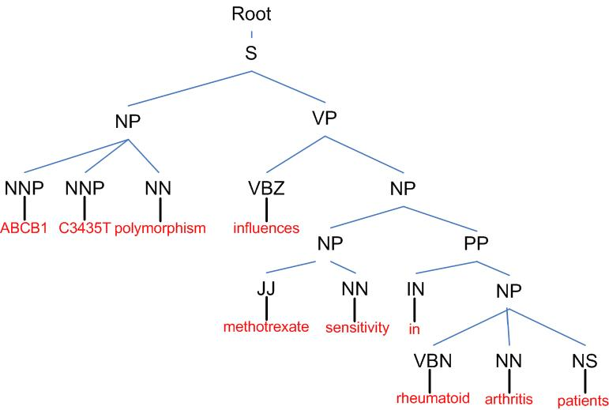
Syntactic Parsing
Notes:
There are many syntactically valid parses of an input sentence but only one that is correct in terms of what the author meant.
The idea behind statistical parsing, pioneered by Chris Manning here at Stanford, was to take a guess at the most likely parse based on frequency of use of various sentence structures. It relies on a corpus of training data which has already been annotated (parsed by hand). Typically the one used is a collection of Wall Street Journal articles. In our work we have found that even without retraining a parser on medical text, from WSJ, it works well.

Slide 12
Named entity recognition
Task: Identify entities of interest in a block of text and assign appropriate category label(s).
The | patient | has | coronary | artery | disease | and |
has | undergone | multiple | balloon | angioplasties | .
disease
procedure
Notes:
Named entity recognition (NER) (also known as entity identification and entity extraction) is a subtask of information extraction that seeks to locate and classify atomic elements in text into predefined categories such as the names of persons, organizations, locations, expressions of times, quantities, monetary values, percentages, etc.
For medical entities, remember the UMLS Semantic Network.

Slide 13
Section detection
Task: Understand document structure to find parts of documents – e.g. the past medical history section of a clinical note.
Medical history : The patient has coronary artery disease and has undergone multiple balloon angioplasties .
The | patient | has | coronary | artery | disease | and |
has | undergone | multiple | balloon | angioplasties | .

Slide 14
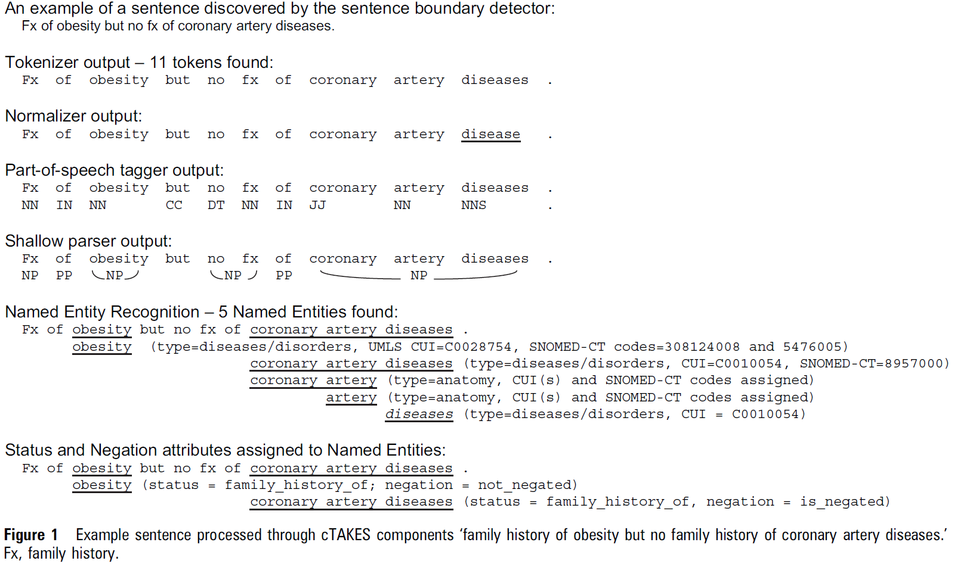
cTAKES example processing

Slide 15
Lessons from decades of clinical text processing
There are a small number of ways things are said
Information on co-occurrence of diseases, drugs, procedures is useful in many ways
Feature engineering
Electronic phenotyping
Most factual and objective information is identified by simple rules, dictionaries of terms and negation extraction modules
Systems could be greatly simplified with only minor and possibly insignificant sacrifices to accuracy. (Jung et al paper)

Slide 16
Examples of clinical notes

Slide 17
Imagine doing NLP on that!
PGY1 IM H&P
HPI: 54M w/ MMP incl. COPD, HFrEF, stg. IV SSC (?1°, w/ mets to LLL c/b CAP x 3, mets to L-S c/b LBP), p/w CP x 2hr i/s/o SOB & F/C x 3 d. Tmax 102. ROS neg 4 N/V/D, DVT/PE.
ED: AF BP 99/60 P 120 RR 16, CBC w/ WBC 20 w 90% PMN, Cr 1.4 (b/l 1.0), lact neg, rec’d 2L NS, BCx, 1 g IV vanc, 3.375 g IV pip-tazo.
Add’l PMH:
pAF, AC (CHADS-VASC 4)
DM2 (A1C 9)
HTN (b/l SBP ~160s)
COPD (FEV1/FVC 60%)
HFrEF (EF 15% s/p AICD)
CAD (s/p CABG 2012, LHC w/ PCI x 2, 2014 LAD DES, 2015 RCA DES)
PSH:
LLL Bx 4/2017 w/ VATS
Ex-lap 1990 i/s/o GSW
Lap-Choly 1992
Rx: BB, ARB, Atorva, NOAC, NKDA

Slide 18
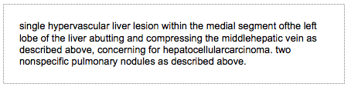
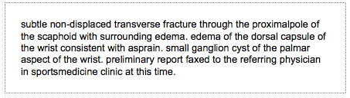
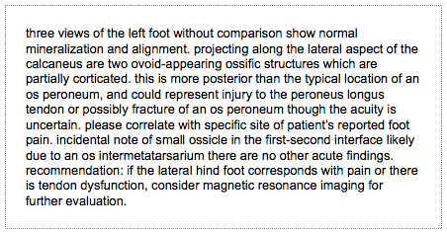
Radiology notes
CT scan of liver
MRI of wrist
X-ray of foot
© Stanford University, radTF database

Slide 19
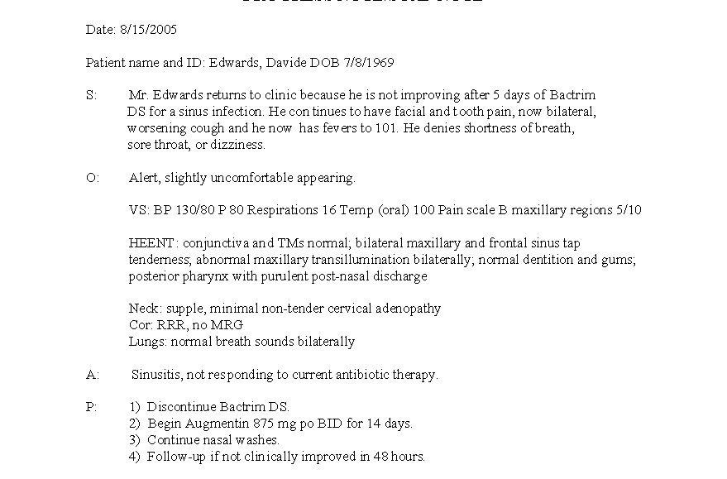
Progress note: SOAP format
© University of New Mexico School of Medicine

Slide 20
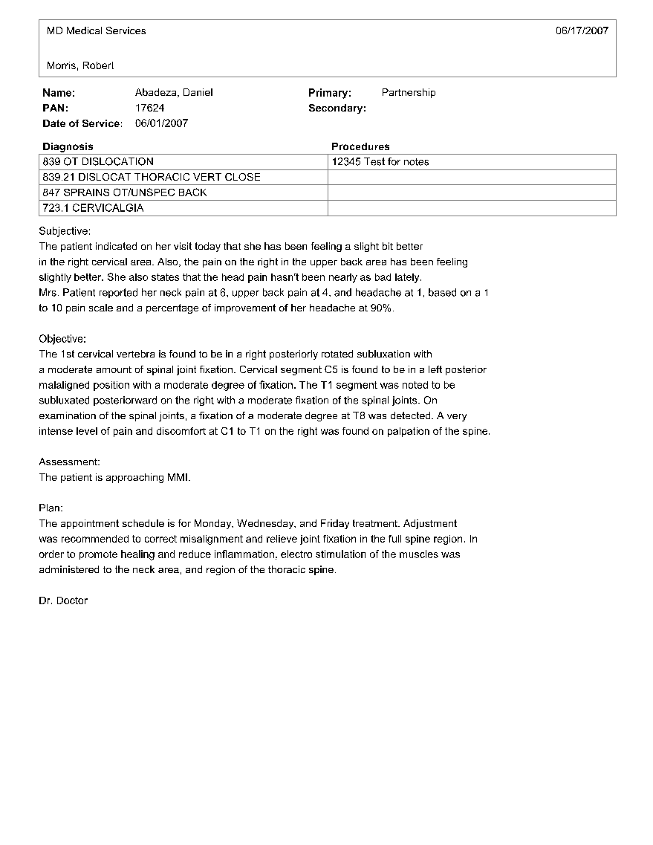
Progress note: SOAP format II

Slide 21
My take: Problems unique to clinical text
Ungrammatical, has misspellings and concatenations. Contains short telegraphic phrases, acronyms, abbreviations, which are often overloaded = haiku of acronyms
Some sources are dictated and composed deliberately for clear communication (radiology reports) while others are written for documentation (progress notes) = high variance in quality
Can contain many things that can be typed or pasted, such as long sets of lab values or vital signs = pasted in junk
Idiosyncratic and institution-specific template-use is common = lot of copy-pasting
Pervasive fear, misunderstanding, and confusion around security, privacy, de-identification, and anonymization = ridiculous amount of agony in getting access

Slide 22
‘Just enough’ text processing
Practical tips from our research group

Slide 23
Two options for how to handle text
Redact “PHI”
[*** name ***] examined a patient with osteoarthritis. The patient is a female CEO of an internet company on page mill road, with several buildings requiring her to walk between offices. Patient complains that pain worsens on walking.
Proceed to NLP
Dr. Nigam Shah examined a patient with osteoarthritis. The patient is a female CEO of an internet company on page mill road, with several buildings requiring her to walk between offices. Patient complains that pain worsens on walking.
Keep “medical terms”
patient osteoarthritis. patient
female
walk
Patient complains pain worsens walking.
Proceed to “data mining”

Slide 24
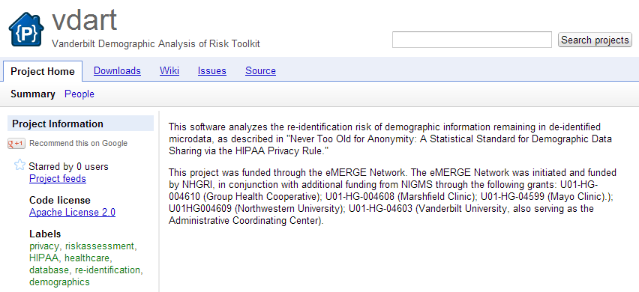
De-identification vs. Anonymization
The removal of 18 specific identifiers (Safe Harbor Method):
Names
Geographic data
All elements of dates
Telephone numbers
FAX numbers
Email addresses
Social Security numbers
Medical record numbers
Health plan beneficiary numbers
Account numbers
Certificate/license numbers
Vehicle identifiers and serial numbers including license plates
Device identifiers and serial numbers
Web URLs
Internet protocol addresses
Biometric identifiers (i.e. retinal scan, fingerprints)
Full face photos and comparable images
Any unique identifying number, characteristic or code
Have a statistician validate and document that the statistical risk of re-identification is very small (Statistical Method)
Also called “scrubbing”
HIPAA zip code rule (45 CFR 164.514) permits revealing 3-digit ZIP codes as long as the 3-digit ZIP code covers an area populated by more than 20,000 people, as this is considered to be sufficient “masking” of the individual.
Notes:
De-identification = identifiers are hidden, masked or removed
Anonymization = data cannot be linked to identify the patient … impossible to guarantee

Slide 25
Hiding in plain sight
**Redacted PHI &
Leaked PHI
Surrogate PHI &
Hidden PHI
Original PHI
Smith, 61 yo ... | **pt_name<A>, **age<60s> yo ... | Jones, a 64 yo ...
daughter, Lynn, to ... | daughter, Lynn, to ... | daughter, Lynn, for ...
oncologist Dr. White ... | oncologist Dr. **MD_name<C> ... | oncologist Dr. Howe ...
5/13/10 to consider ... | **date<5/28/10> to consider ... | 5/28/10 to consider ...
SWOG protocol 1811, ... | SWOG protocol **other_id, ... | SWOG protocol 1798, ...
was randomized 5/10 ... | was randomized 5/10 ... | was randomized 5/10 ...
to call Mr. Smith on ... | to call Mr. **pt_name<A> on ... | to call Mr. Jones on ...
PLAN:Dr White and I ... | PLAN:Dr White and I ... | PLAN:Dr White and I ...
Idea: Inject surrogated information to hide the leaks!
Carrell et al., JAMIA 2013
Notes:
Slide provided by Bradley Malin, at Vanderbilt University

Slide 26
Need to know: about a term
How often is it used, and how?
Is it an ambiguous term?
What alternative terms should you consider?

Slide 27
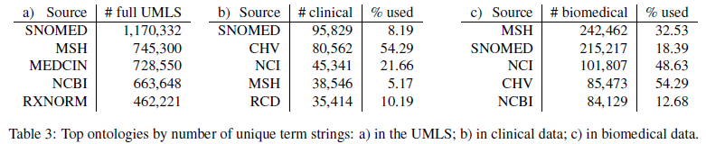
Decide which terms to keep

Slide 28
Decide which terms are confusing
Compare string similarity
Notes:
Focus on the “most frequent” things
E.g. Coden et al train a classifier for the top 50 ambiguous terms

Slide 29
What terms are used interchangeably
31 terms: ache, aches, aching, achy, buring, burning, coldness, cramping, discomfort, heaviness, hurt, hurting, hurts, insensitivity, itchiness, itching, numb, numbness, pain, painful, pains, paresthesia, paresthesias, sensitive, sensitivity, soreness, tender, tenderness, throbbing, tightness, tingling
14 terms: ache, aching, burning, discomfort, hurt, hurting, numb, pain, painful, sensitive, sensitivity, tender,
tenderness, tingling,

Slide 30
Need to know: about a term mention
Negation
Context
Does it apply to the patient or someone else
Is it current or in the past
Uncertainty
Notes:
Section headings are all caps followed by a colon … easy to identify, and give lots of contextual information.

Slide 31
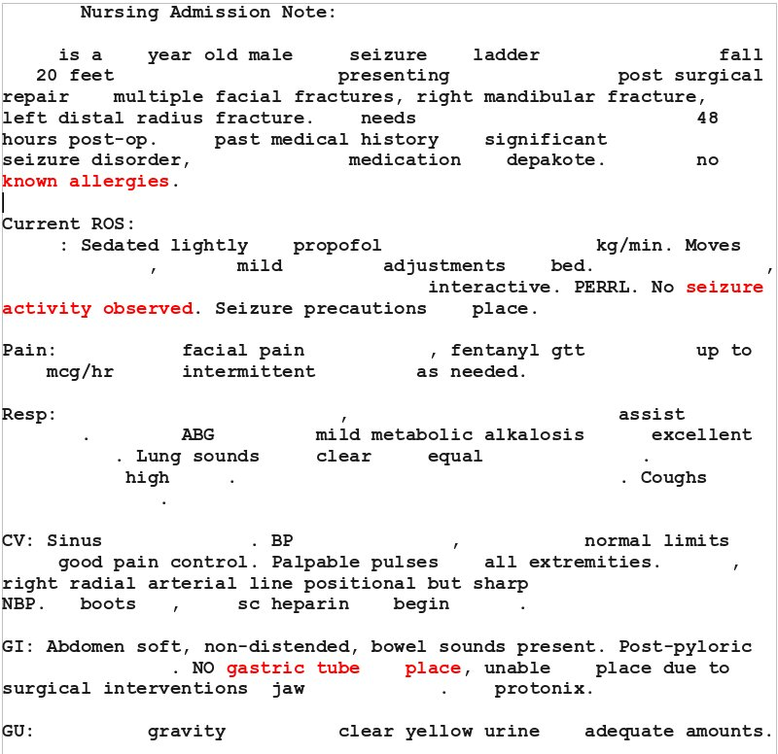
Negation and Context detection
no abnormal [PREN]
no cause of [PREN]
no complaints of [PREN]
no evidence [PREN]
no new evidence [PREN]
no other evidence [PREN]
no evidence to suggest [PREN]
no findings of [PREN]
no findings to indicate [PREN]
no mammographic evidence of [PREN]
no new [PREN]
no radiographic evidence of [PREN]
no sign of [PREN]
no significant [PREN]
no signs of [PREN]
no suggestion of [PREN]
no suspicious [PREN]
not [PREN]
not appear [PREN]
not appreciate [PREN]
not associated with [PREN]
not complain of [PREN]
not demonstrate [PREN]
not exhibit [PREN]
not feel [PREN]
not had [PREN]
Negex and Contex projects
https://github.com/chapmanbe/pyConTextNLP

Slide 32
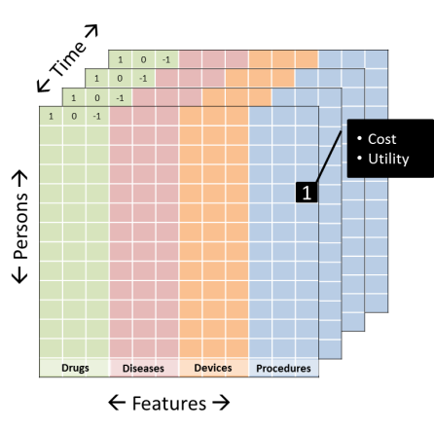
Remember:
Data mining is a process
Text is one source to use [be careful how deep you go!]
Notes:
You can evaluate your “text processing” ability at many levels:
The ability to find terms, disambiguate, handle typos etc.
The ability to deduce which terms are used interchangeably.
The ability to infer conditions (e.g. mention of a cluster of words that indicate the person having a disease)
The ability to create accurate parse trees, identify named entities etc.
The increase in phenotyping fidelity you get
The increase in the ability to answer the question you have --- a FUNCTIONAL evaluation

Slide 33
Optional reading
Jung, KJ et al. Functional evaluation of out-of-the-box text-mining tools for data-mining tasks.
J Am Med Inform Assoc. 2015 Jan;22(1):121-31. doi: 10.1136/amiajnl-2014-002902. Epub 2014 Oct 21. PMID: 25336595; PMCID: PMC4433377.
Fries, JA et al. Ontology-driven weak supervision for clinical entity classification in electronic health records.
Nat Commun 12, 2017 (2021). https://doi.org/10.1038/s41467-021-22328-4. PMID: 33795682 PMCID: PMC8016863

